Slide 1
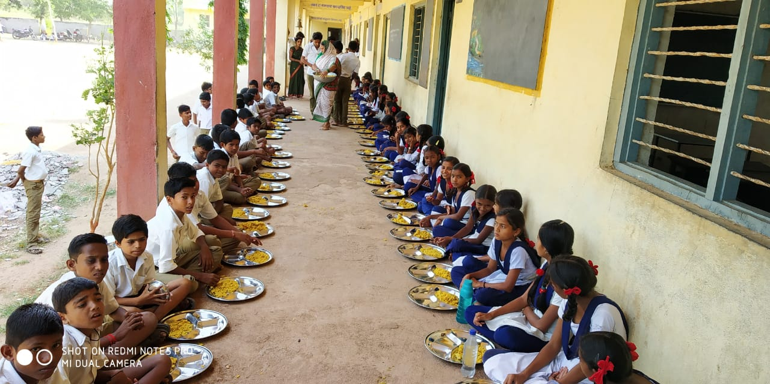
Dept. of School Education
Govt. of Maharashtra
Annual Work Plan & Budget 2019-20

Slide 2
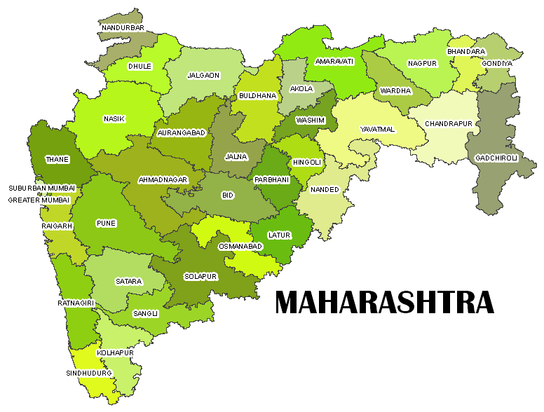
Maharashtra State Profile
1
No of District
36 Districts
Maharashtra State
2
No. of Blocks
407 Blocks
3
No. of Municipal Corporation
26 Municipal Corporation

Slide 3
Number of Schools & Children During Year 2019-20
Type | No of Schools | Actual Enrollment | No of children | No of Working Days for 2019-20
Primary | 46577 | 64.98 lakh | 64.98 lakh | 231 Days
Upper Primary | 39827 | 42.86 lakh | 42.86 lakh
NCLP | 143 | 0.037 lakh | 0.037 lakh | 289 days
Total | 86547 | 107.84 Lakh | 107.84 lakh

Slide 4
Best Practices
1. Kitchen Garden
The state is promoting the concept of establishing kitchen gardens in schools. So far in 10856 schools kitchen gardens are established and it is in progress in 6411 schools. This year we propose to establish kitchen gardens in 20000 schools.
Schools with space constraint are encouraged to establish vertical kitchen garden.

Slide 5
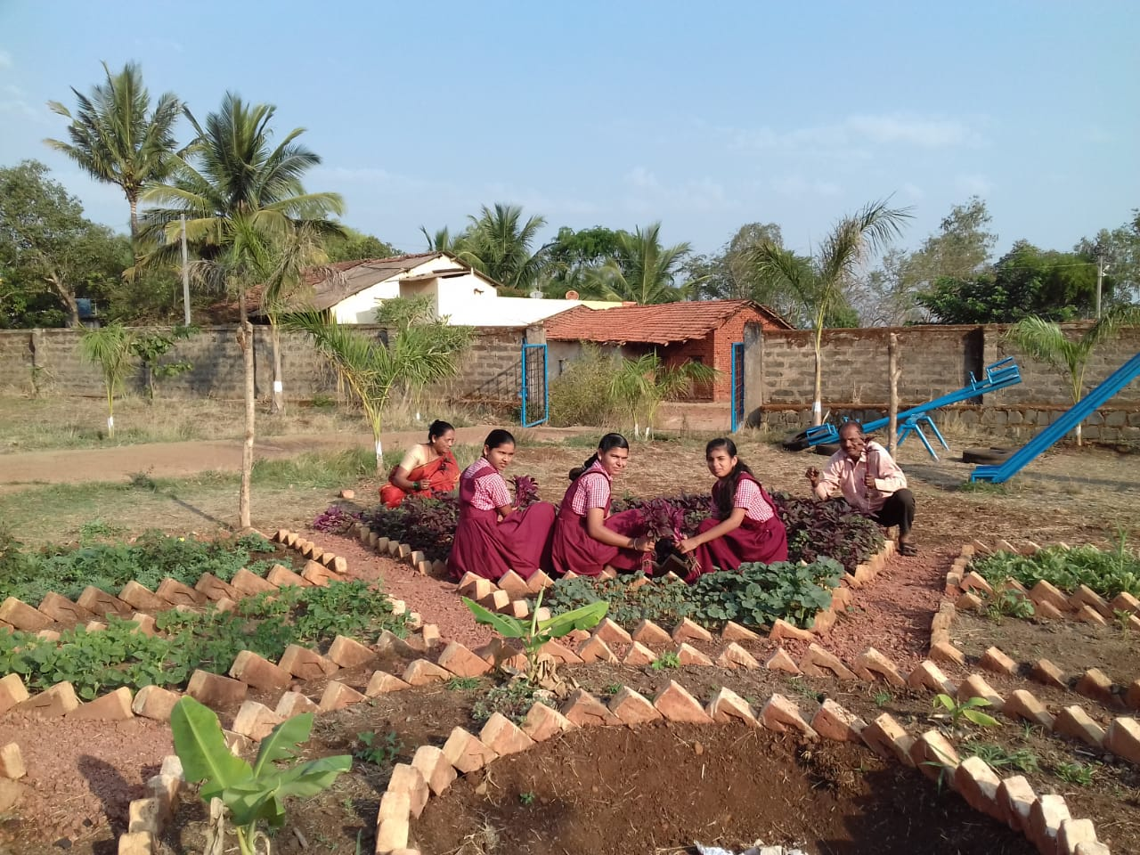
ZPPS HASUR TAL. CHANDGAD DIST- KOLHAPUR

Slide 6
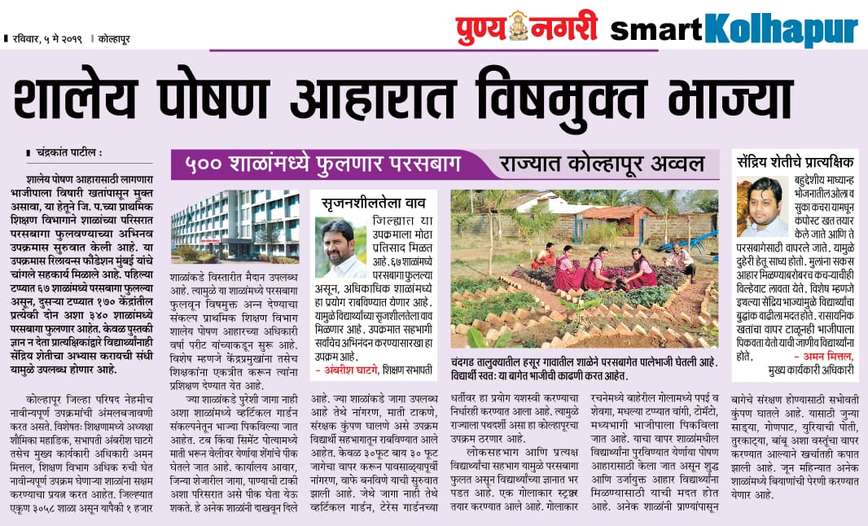
News related Kitchen Garden using compost

Slide 7
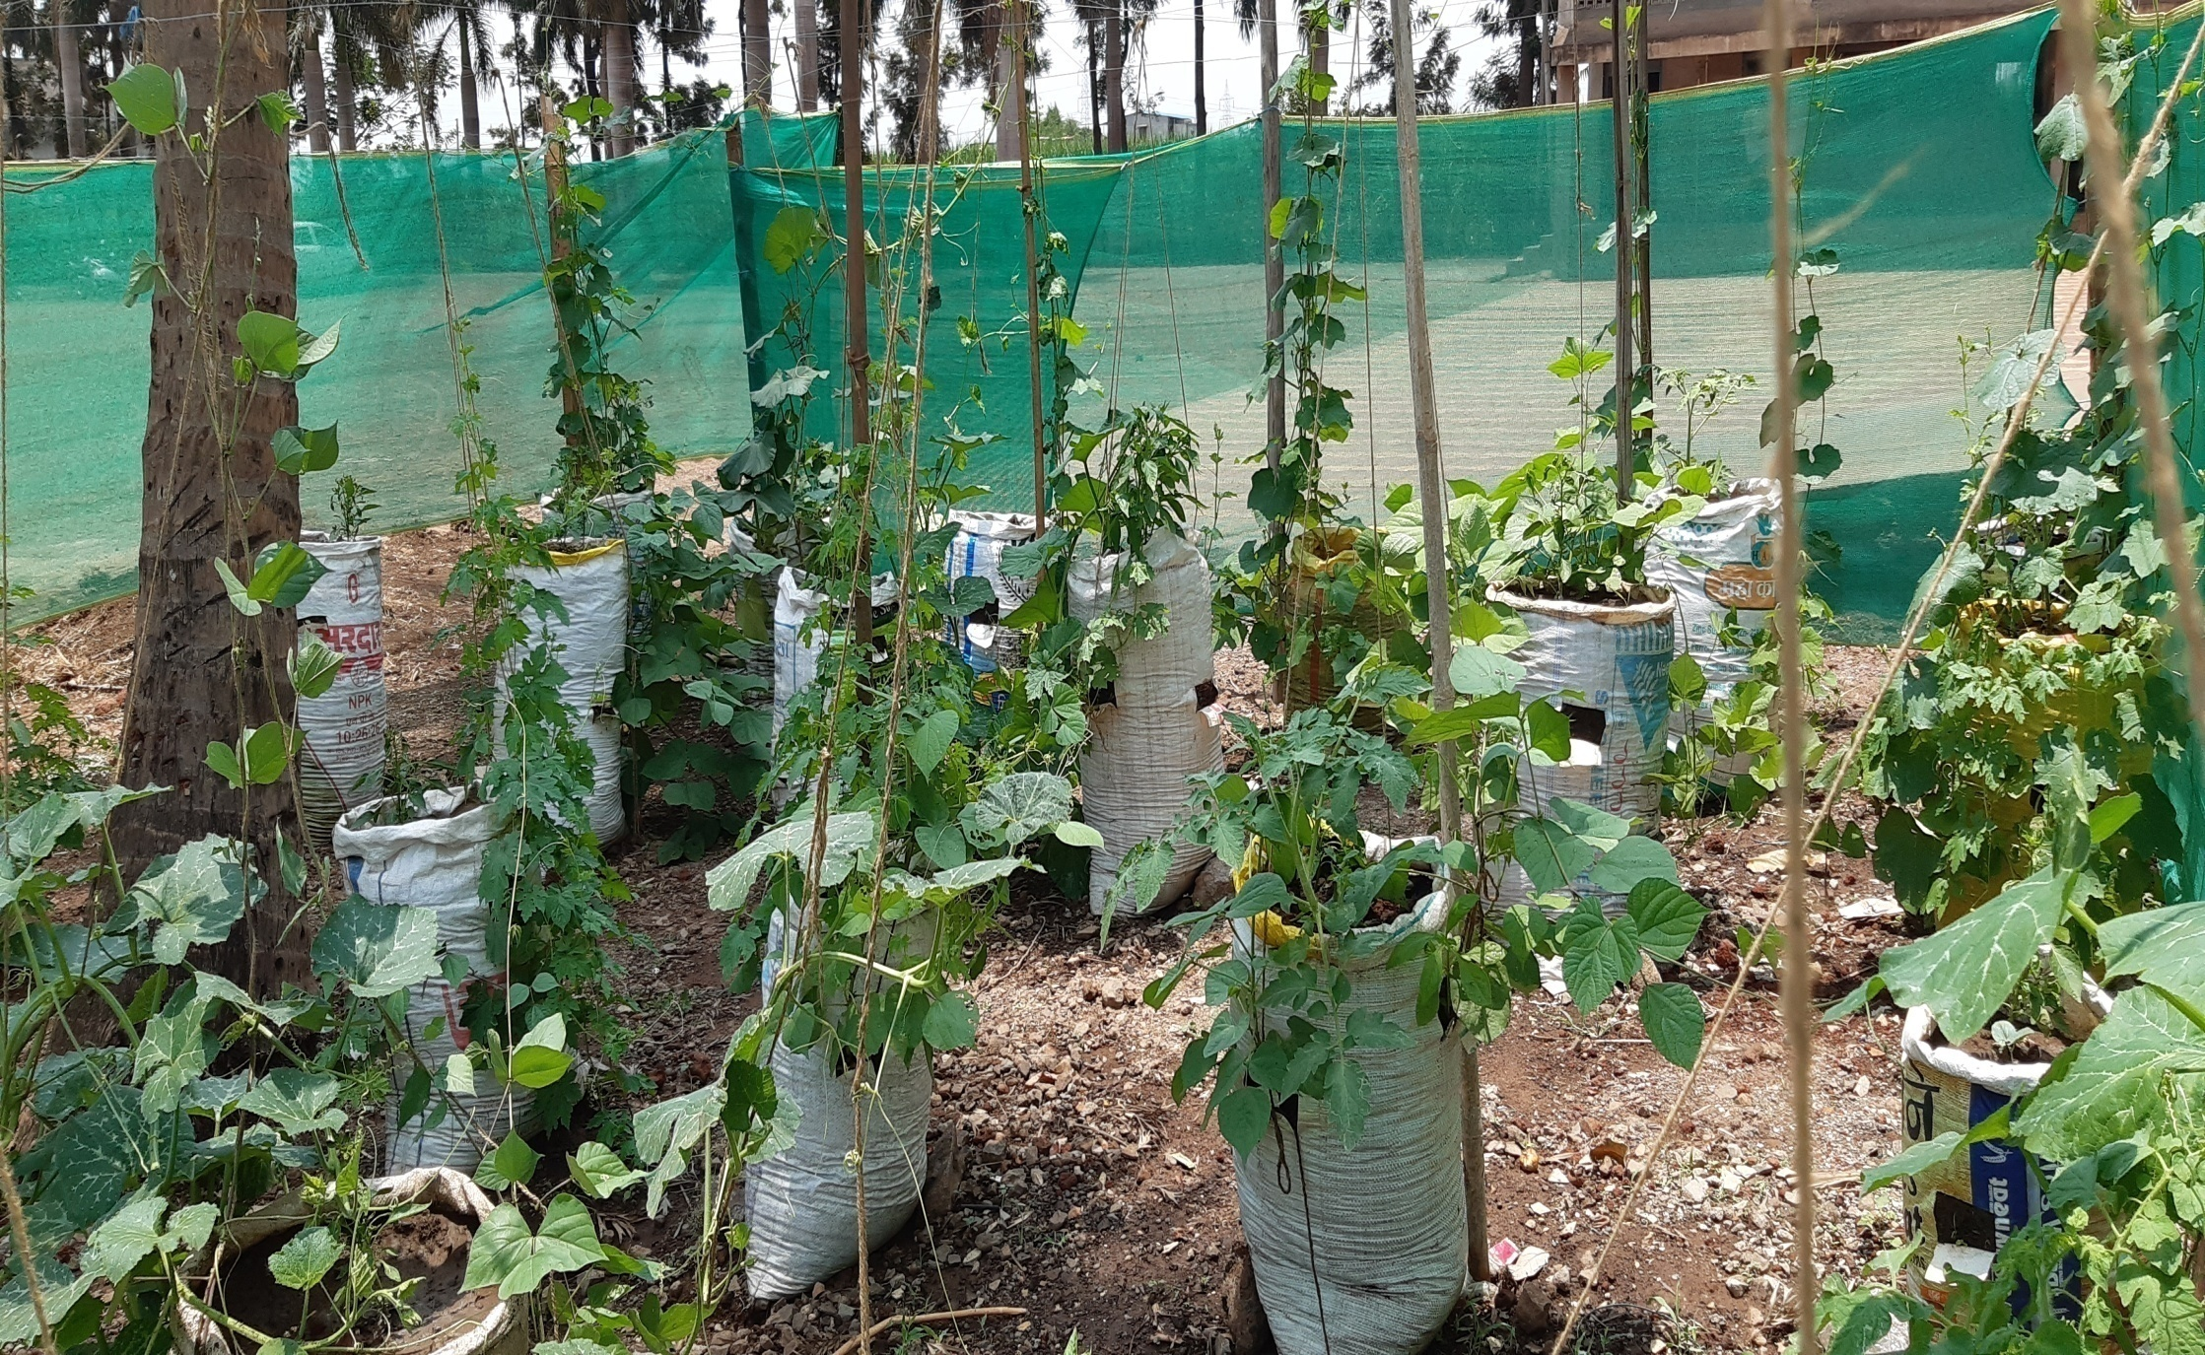
Bapuso Hupare High school Pattan kodoli Tal Hatkanangale Dist. Kolhapur

Slide 8
2. Sneh Bhojan -
Sneh bhojan is a community participation programme.
Community provides a full meal or additional items on special occasions like birthdays, marriages, anniversaries , days of national importance and other local festivals etc
No. of children benefited in the year 2018-19 : 13,49,887

Slide 9
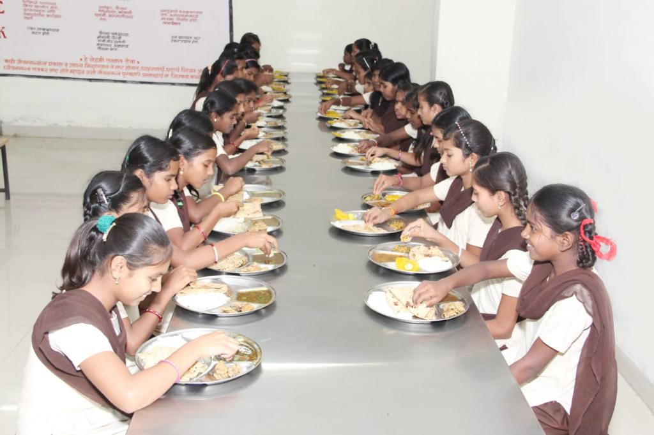

Slide 10
3. Cooking Competition
In Satara and Kolhapur districts in 367 clusters, cooking competitions were organised by Block Level Officers involving teachers , SMC members and villagers to encourage preparation of different types of nutritious and delicious food recepies.

Slide 11
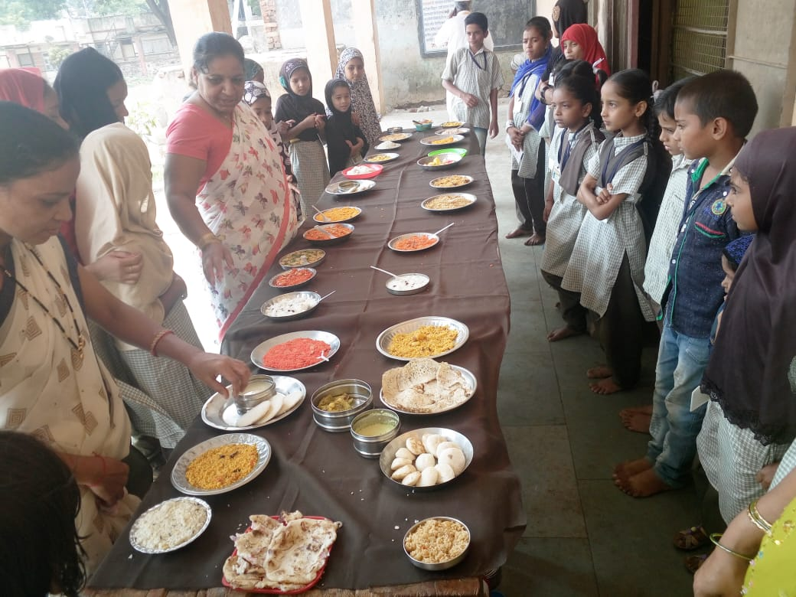
VIDYA MANDIR DINDNERLI , KOLHAPUR

Slide 12
4. Supplementary food in drought prone areas
As per Hon’ble Supreme Court guidelines, Maharashtra Government has decided to provide additional supplementary food like Milk, Fruits and Eggs in drought prone areas.

Slide 13
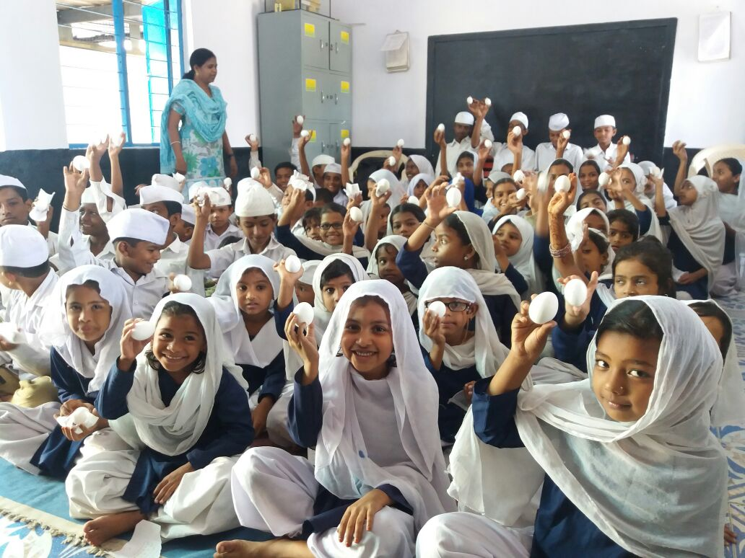
Supplementary food in drought prone area

Slide 14
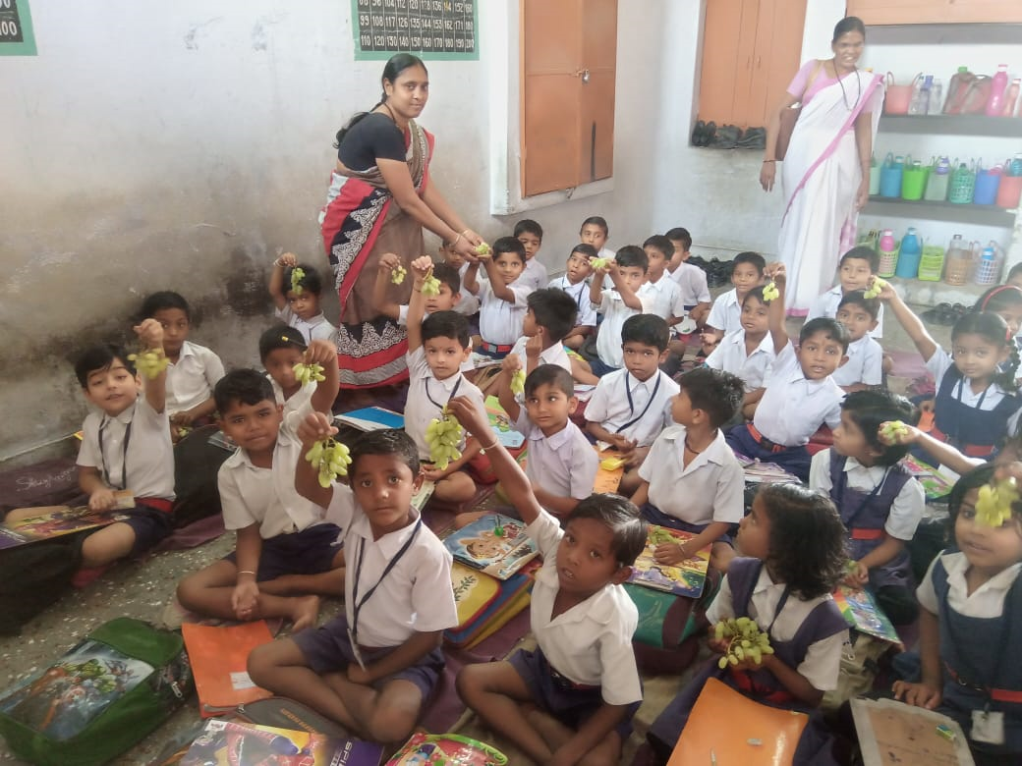
ZPPS HANDEWADI
TAL. GEORAI
DIST. BEED

Slide 15
5.Hand Wash Stations
Hand wash stations are established in – 26949 schools.
Orientation programme on Swachch Vidyalaya is conducted in schools and children are encouraged to wash their hands before and after meals.
Hand wash station initiative is appreciated by JRM.

Slide 16
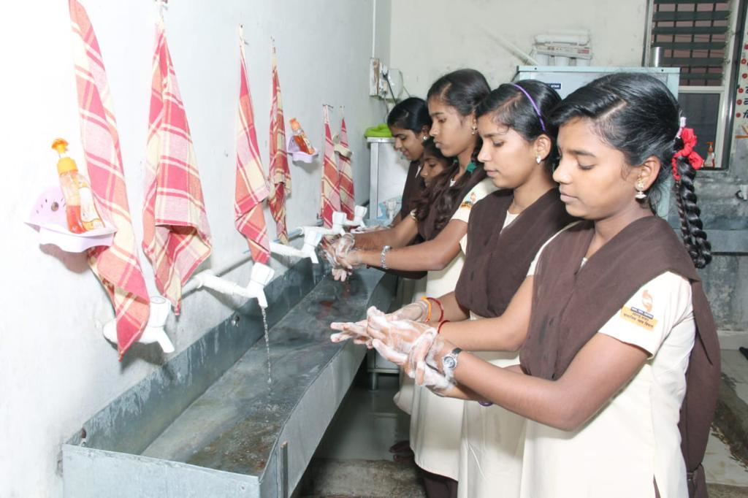
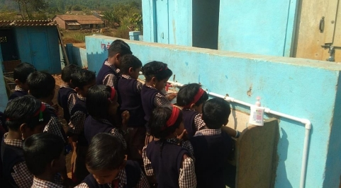
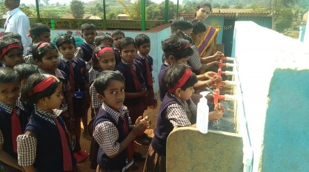
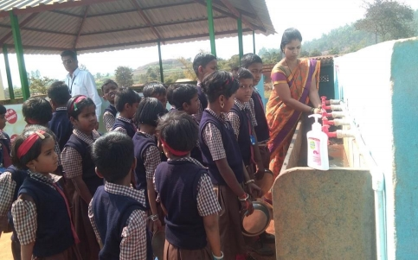

Slide 17
6. Automated Monitoring system (MDM Portal)
The state has developed an Automated Monitoring System (MDM Portal) under “SARAL “with the help of NIC Pune.
Daily number of meals served by schools can be filled by three options
i) Mobile Application
ii) Text message (SMS)
iii) Website

Slide 18
7. Direct Grant upto School level from State
Directorate of Primary Education
Rice payment to FCI
Rice Transportaion charges to supplier
School Management Committee
District Education Officer
Self Help Groups
Cooking Cost , MME
Payment to supplier for Food Grains & direct payment to cooks

Slide 19
Points appreciated by Joint Review Mission
Buffer stock of food grains were maintained in all the visited schools.
E_transfer of Cooking cost to schools directly from state.
Sneh bhojan – local people offer sweets, fruits, meals etc. on special occasions like birthdays, marriages etc. to the school children.

Slide 20
Points appreciated by Joint Review Mission
Midday meal committee involving parents and teachers in Satara district.
Eating plates were available to all students in Govt. schools.
Kitchen gardens are maintained in some of the visited schools.
RO plants (water purification) were available in some schools, these were donated through CSR or from community members.

Slide 21
Points appreciated by Joint Review Mission
LPG is being used as fuel in almost all schools in Satara district.
Mandatory health check up of cook cum helpers, twice a year.
Mobile app is in use for furnishing information related to implementation of MDM.

Slide 22
Proposed innovative Interventions from 5% flexi funds
Developing kitchen gardens
(Total No. of schools proposed 20000)
Supply of eggs – 50 days per year
(No. of dist. proposed 4, No. of children – 4.5 lac)
Supply of millets laddu / biscuit /chikki – 50 days per year
(No. of dist. proposed 12, No. of children – 26.00 lac)

Slide 23
Innovative Interventions
Supply of Oranges – 25 days per year
(No. of dist. proposed 6, No. of children – 12.00 lac)
Supply of Bananas – 30 days per year
(No. of dist. proposed 5, No. of children – 16.50 lac)
Supply of flavored milk powder – 25 days per year
(No. of dist. proposed 6, No. of children – 24.50 lac)

Slide 24
Issues for consideration
1. MDM Optional for students
Many children in metros like Mumbai bring their own tiffins/ lunch boxes.
Some children consume a small part of the MDM, other don’t.
2. Rice Quantity
On average rice consumed is 50 gm & 75 gm for primary & upper primary students. So quantity of rice needs to be reduced.

Slide 25
Issues ..
3. Payment to Cook cum helper
Payment is currently made directly from the district level. It is proposed that payment be made through School / SMC.
4. Cook cum helpers honorarium
- Currently honorarium is Rs. 1000/- per CCH per month. It needs to be increased upto Rs.2000 per month.

Slide 26
Issues…
5. Fortification of salt and oil
GOI has made it compulsory to supply double fortified salt (Iron + iodine) and Fortified edible oil (with Vit A & D).
This adds to cost without matching benefits.
Cost variation of salt and oil as below
Iodized Salt | Double Fortified Salt
Rs. 8 per Kg | Rs. 18 per Kg
Refined Soya Oil | Fortified Edible soya oil
Rs. 95 to 100 per ltr. | Rs. 110 to 115 per ltd

Slide 27
It is proposed that iron, vit A & D fortification can be achieved more effectively and in a more cost effective manner through kitchen gardens, addition of eggs, fruits ,vegetables and flavored milk powder in the diet.

Slide 28
Proposed AWP & B 2019-20 (Central share)
Item | Primary | Upper Primary | NCLP | Total
Requirement of Food grains (In MT) | 132120.44 | 125167.65 | 211.33 | 257499.42
Req. for cost of Food grains (Rs. in lakh) | 3963.61 | 3755.03 | 6.34 | 7724.98
Req. of Food grains for drought (In MT) | 17232.10 | 16872.70 | 0 | 34104.80
Req. for cost of Food grains Drought (Rs. in lakh) | 516.96 | 506.18 | 0 | 1023.14
Req. of Cooking Cost (Rs. in lakh) | 34483.43 | 32627.03 | 55.08 | 67165.54
Req. of Cooking Cost (Rs. in lakh) Drought | 4497.58 | 4398.16 | 0 | 8895.74
Req. of Transport Assistance (Rs. in lakh) | 7495.98 | 7322.77 | 0 | 14818.75
Honorarium for CCH(Rs. in lakh) | 10520.16 | 952.08 (Drought) |  | 11472.24
MME |  |  |  | 2658.66
Kitchen Devices |  |  |  | 7394.07
Kitchen Repair |  |  |  | 107.64
Total Central Share (Rs. in lakh) |  |  |  | 121260.76
Notes:
28
28

Slide 29
Proposed AWP & B 2019-20 (State share)
Item | Primary | Upper Primary | NCLP | Total
Requirement of Food grains (In MT) | 0 | 0 | 0 | 0
Requirement for cost of Food grains (Rs. in lakh) | 0 | 0 | 0 | 0
Requirement of Cooking Cost (Rs. in lakh) | 22988.95 | 21695.7 | 36.63 | 44721.28
Requirement of Cooking Cost For Drought(Rs. in lakh) | 2998.39 | 2924.6 | 0 | 5922.99
Requirement of Transport Assistance (Rs. in lakh)
Honorarium for cook cum helper (Rs. in lakh) | 7013.13 | 634.72 (Drought) |  | 7647.85
Kitchen Devices |  |  |  | 4929.38
Kitchen Repair |  |  |  | 71.76
Total State Share (Rs. in lakh) |  |  |  | 63293.26
Notes:
29
29

Slide 30
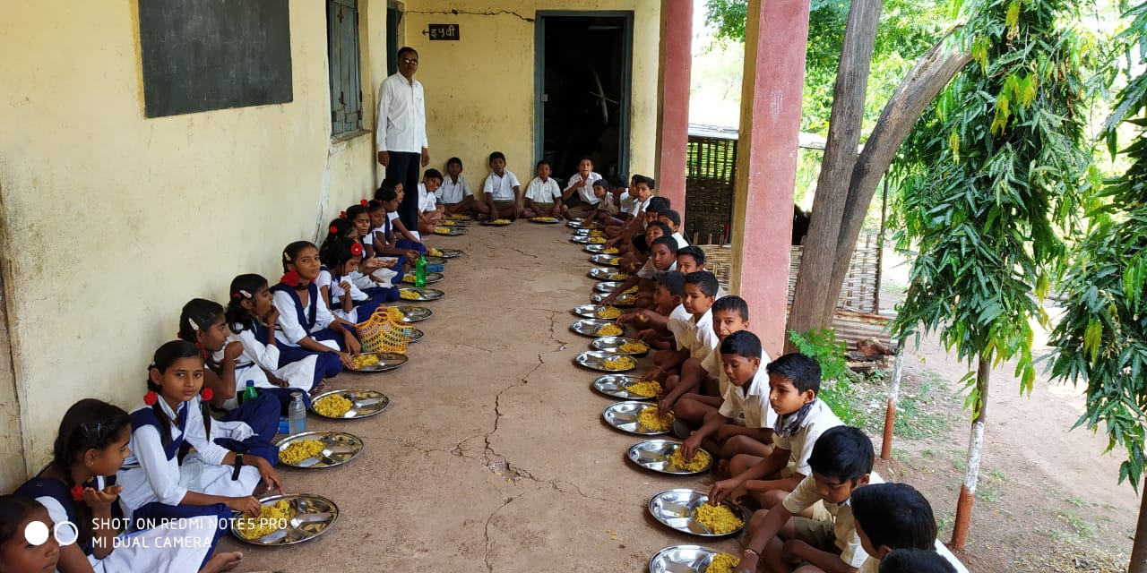
Thank you

